Slide 1

ITI
Introduction to Computer Networks & Cyber Security

Slide 2
Building the network
What do you need to build your network?

Slide 3
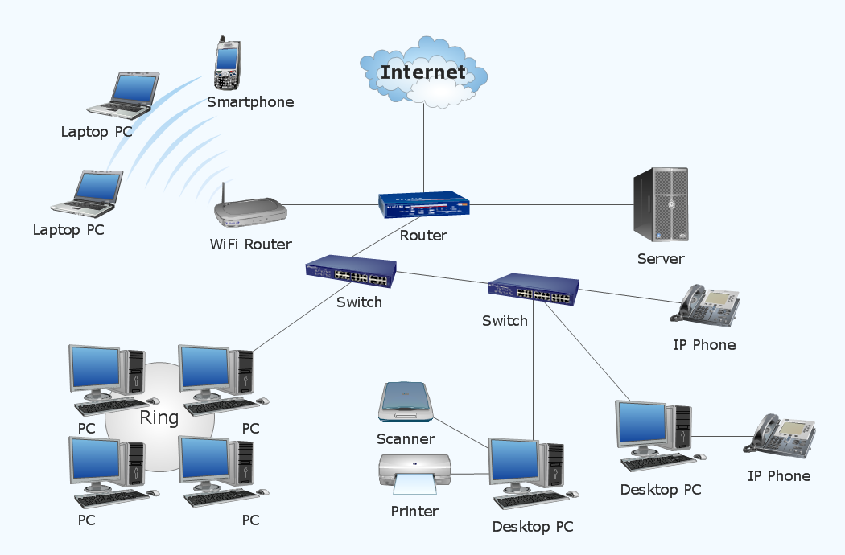
Simple Network

Slide 4
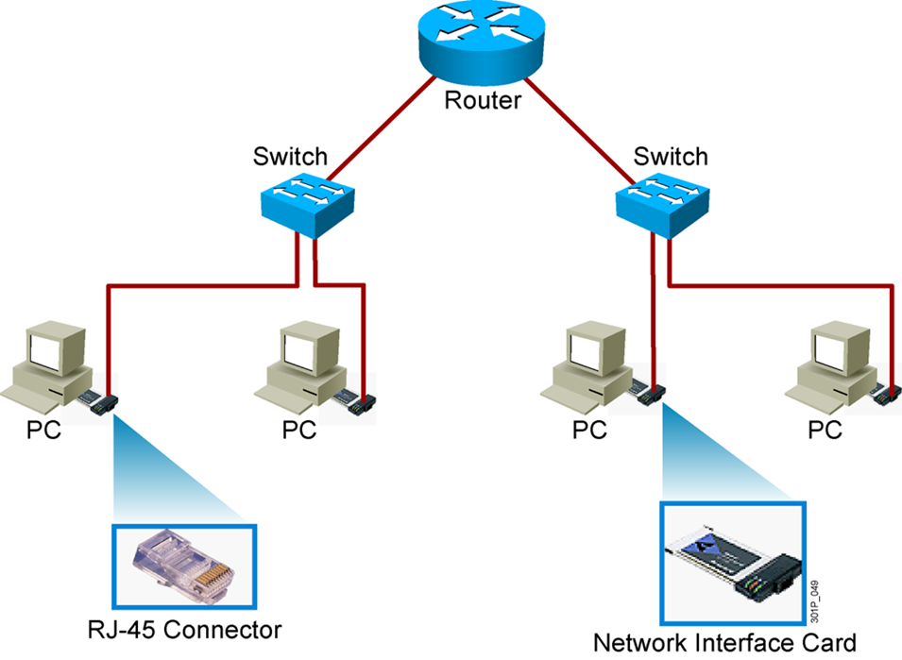
Basic Network Elements ( Hardware / Software )
Hardware
Devices
Computers – Printers –Phone – Routers - Switches
Medium
Wired -Wireless –Satellites
Software
Messages
Information that travels over the medium
Mails-WhatsApp….etc
Protocols
Governs how messages flow across network
http –https-FTP-RDP

Slide 5
Basic Network Elements (Software)
Software Protocols

Slide 6
Basic Network Elements (Software)
What is Protocols ?
- Communication rules that all entity must agree on
- Method to connect internetworking elements
Why we need Protocols ?
To communicate efficiently
Enable data to flow from one NIC to another
Control the messages and the messages quantity in the network.

Slide 7
Host to Host Communication
Older Model
Proprietary
Application and combinations software controlled by one vendor
Standard based Model
Multivendor software
Layered approach

Slide 8
Part 1_Basic Network Elements (Software)
Open Systems Interconnection Reference Model OSI RM

Slide 9
Part 1_Basic Network Elements (Software)
OSI Reference Model
OSI: Open Systems Interconnect
OSI/RM was defined by ISO in 1983
International Organization for Standardization
OSI Three practical functions
Give developers universal concepts so they can develop protocols
Explain the framework used to connect heterogeneous systems
(Client/server can communicate even if they have different OS)
Describes the process of packet creation
The OSI reference model breaks this approach into layers.

Slide 10
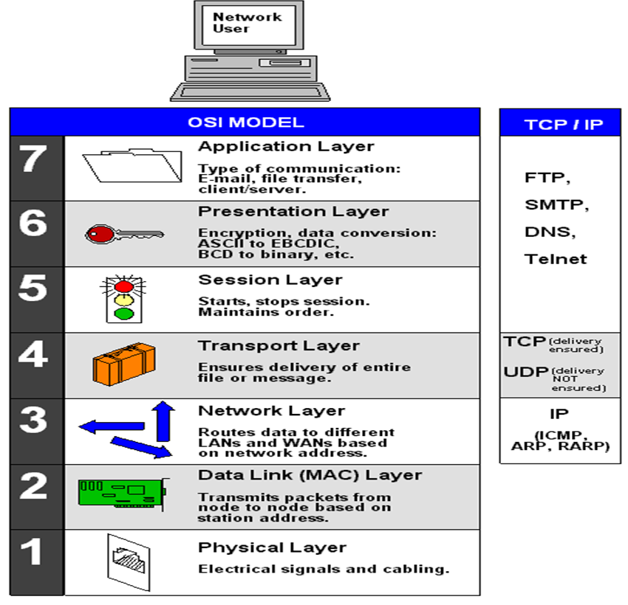
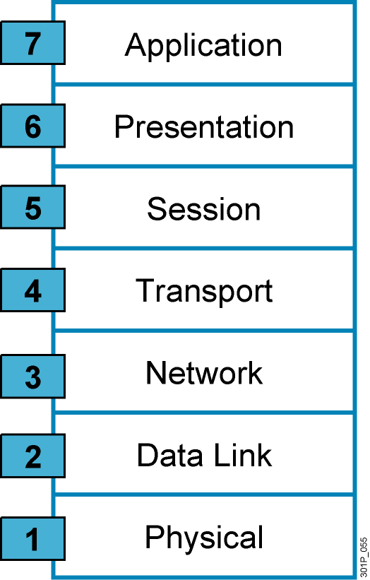
Part 1_Basic Network Elements (Software)
Why a Layered Network Model?
Reduces complexity
Easier to troubleshooting
Standardizes interfaces
Multiple-vendor
Layer Separation - Changes in one layer do not affect other layers
Simplifies teaching and learning

Slide 11
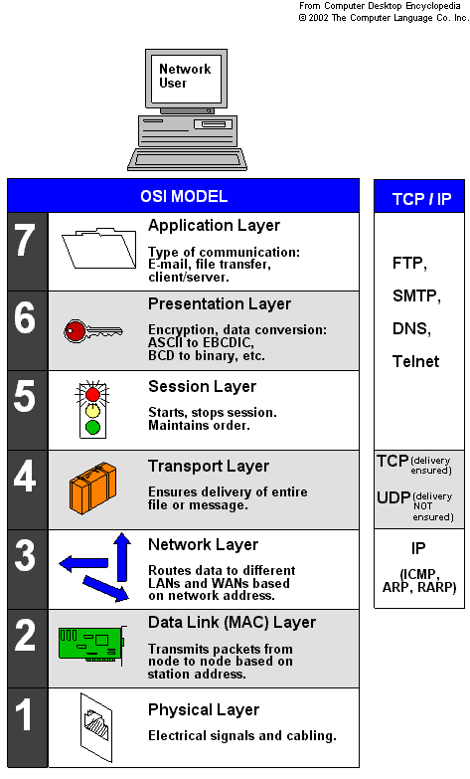
Part 1_Basic Network Elements (Software)
OSI (7-Seven Layers)
Application
Presentation
Session
Transport
Network
Data Link
Physical

Slide 12
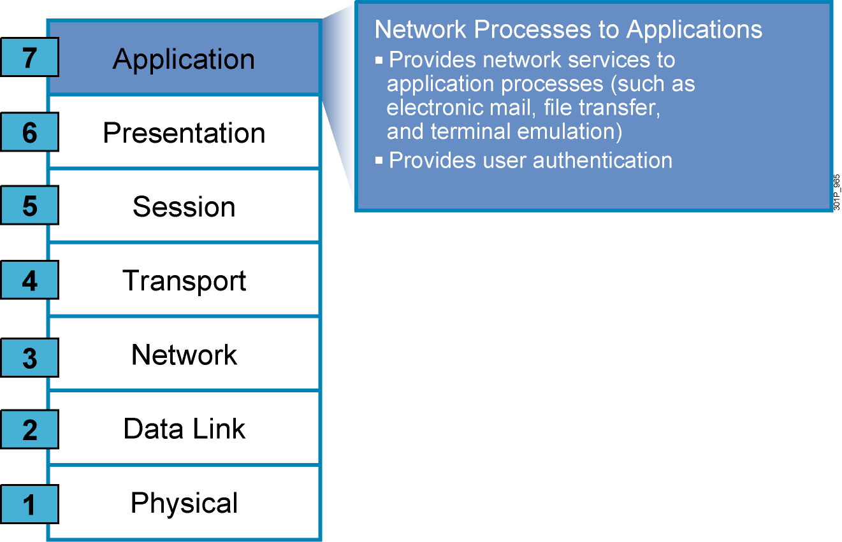
Part 1_Basic Network Elements (Software)_OSI
Application Layer
Interface to end users
provides Many services
File transfer
Network management
Email
Protocols
HTTP (Hyper Text Transfer Protocol)
FTP (File transfer Protocol)
SMTP (Simple Mail transfer Protocol)
POP3 (Post office transfers Protocol)
Telnet/SSH (secure Shell)
Example : Web browser

Slide 13
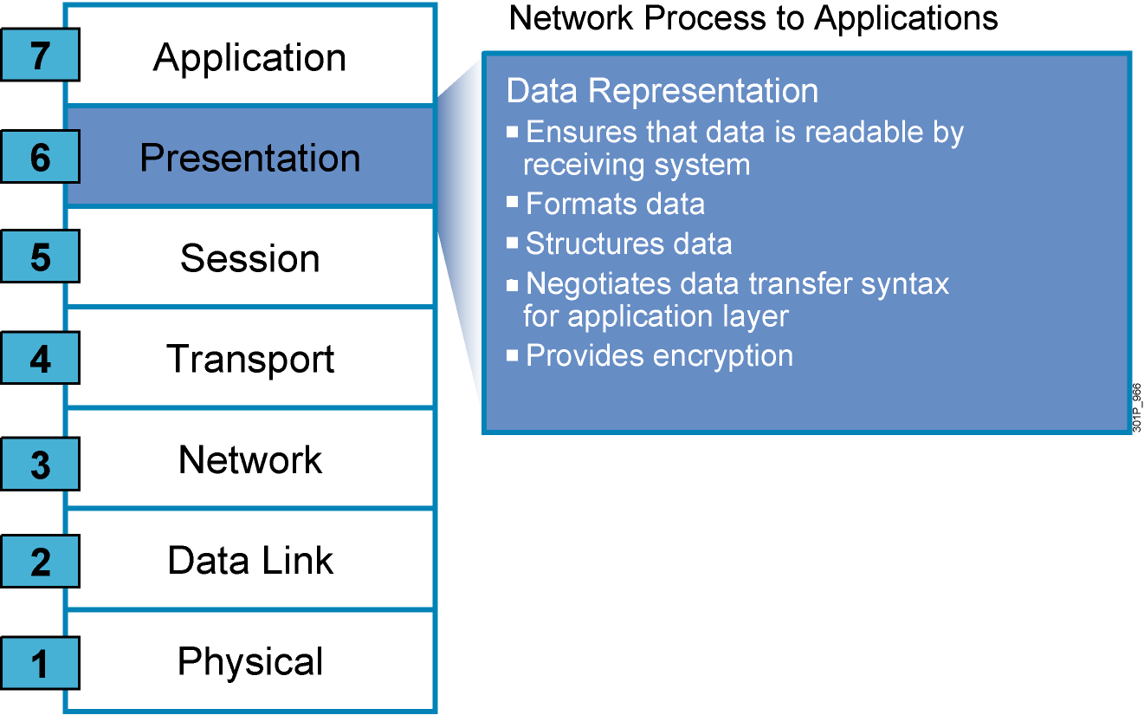
Part 1_Basic Network Elements (Software)_OSI
The Seven Layers Functions (Cont.)
Presentation Layer
Finding common presentation between source and Destination
Ensures that is readable by receiving system
(support standardized application interface)
Formats data
Structured data
Negotiates data transfer syntax for application layer (Encoding and Decoding)
Provides Encryption
Notes:
An example of a presentation service would be the conversion of an EBCDIC-coded text file to an ASCII-coded file.
EBCDIC: Extended Binary Coded Decimal Interchange Code
ASCII: American Standard Code for Information Interchange

Slide 14
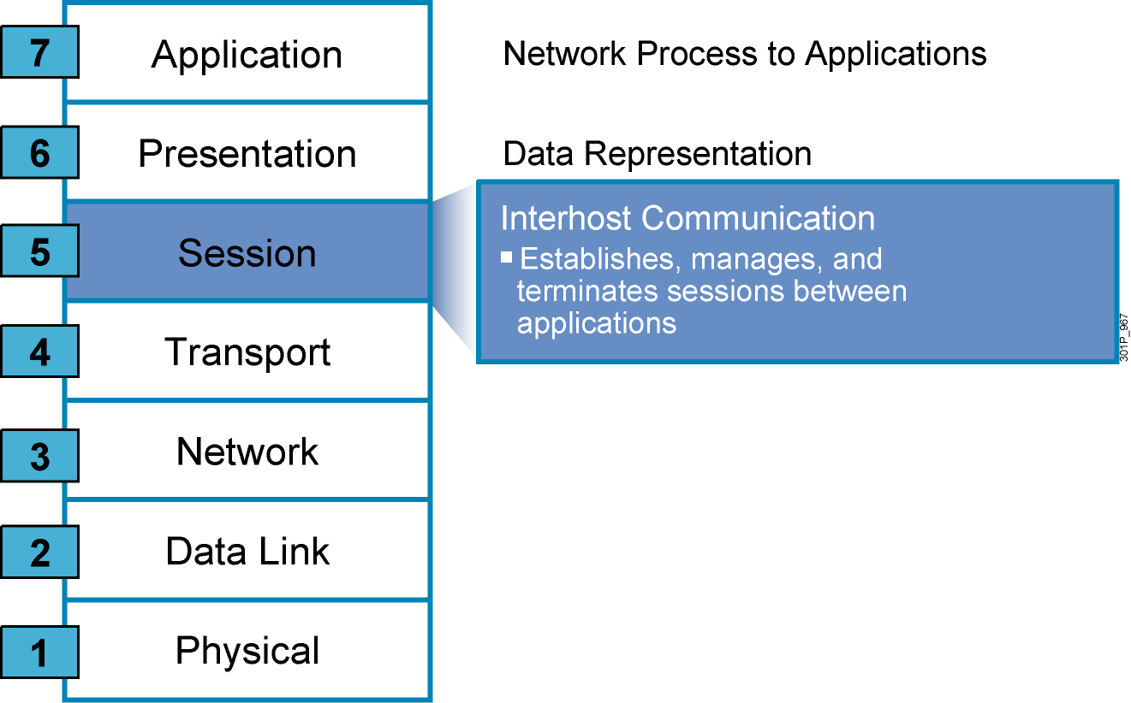
Basic Network Elements (Software)_OSI
The Seven Layers Functions (Cont.)
Session Layer
Establishes, manages and terminates sessions (connections) between cooperating applications (Dialogues)
Synchronization (add checkpoints into a stream of data)
Controls the sessions between the local and remote applications

Slide 15
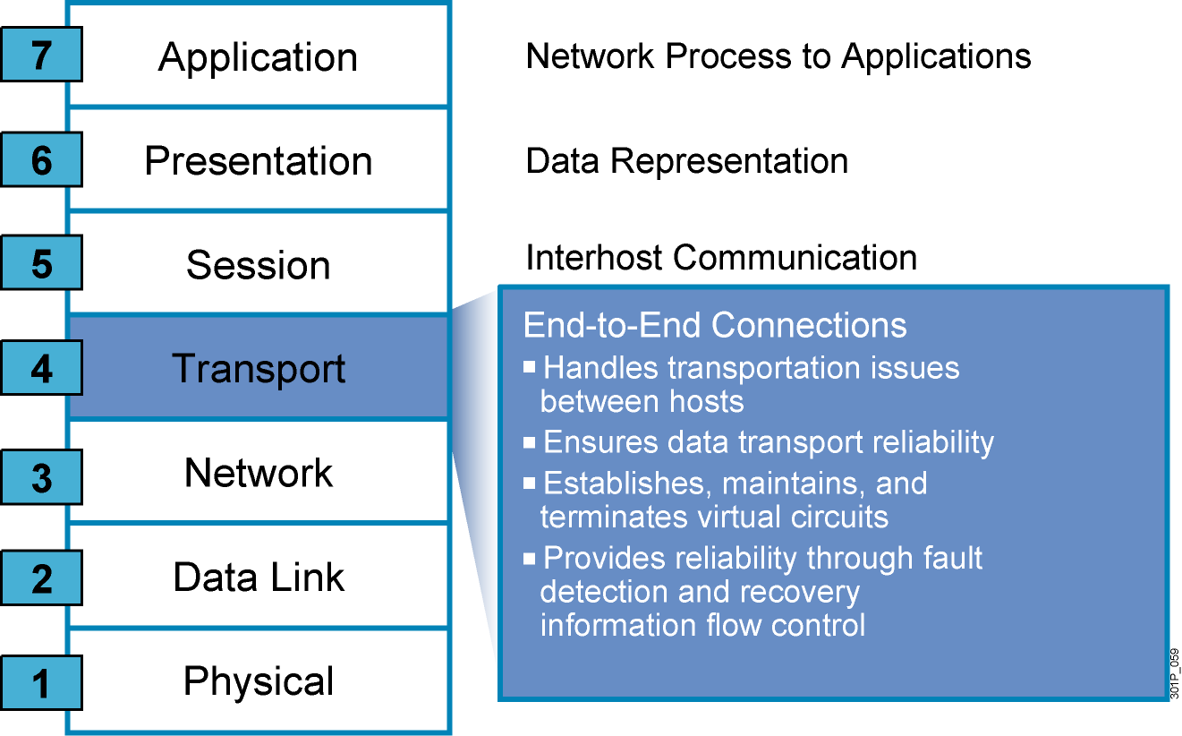
Part 1_Basic Network Elements (Software)
The Seven Layers Functions (Cont.)
Transport Layer
Organize data into Segments
Provide reliable transport between end systems (source and destination hosts)
End-to-end error recovery
End-to-end flow control

Slide 16
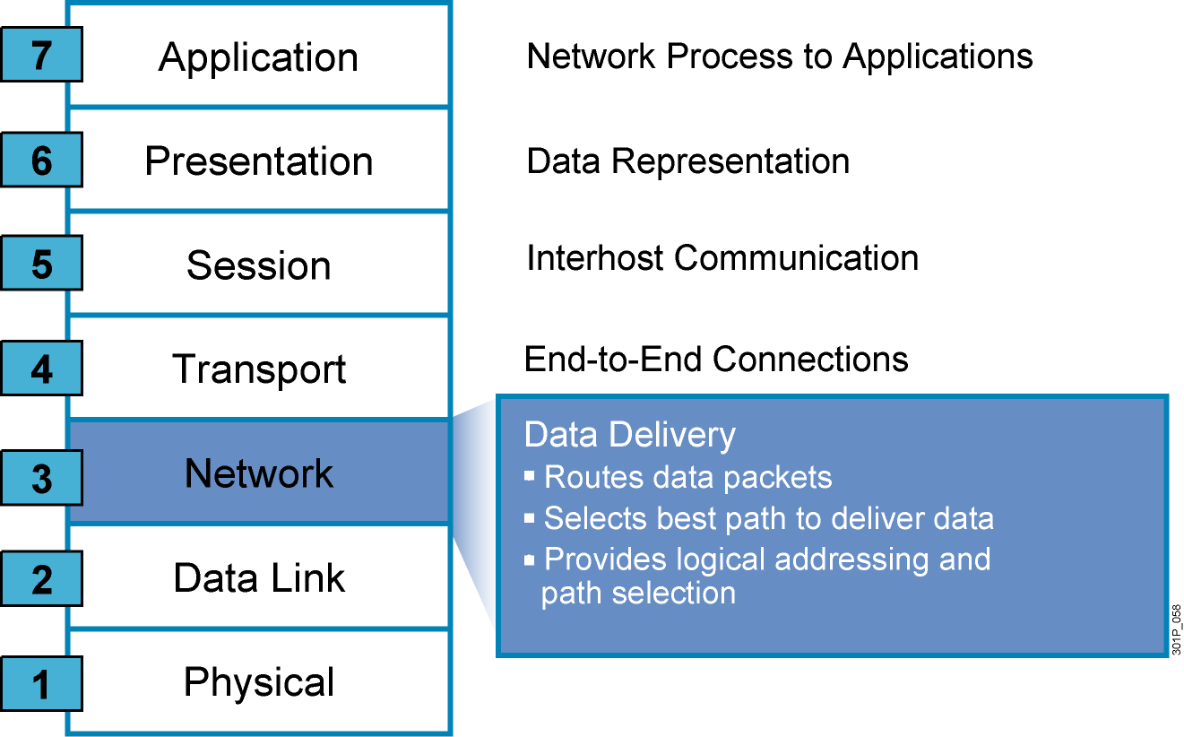
Part 1_Basic Network Elements (Software)
The Seven Layers Functions (Cont.)
Network
Organize data into datagram (packets)
It is responsible for the Internet Protocol Addressing (IP) (Addressing)
It know the best path for the destination (Routing)
End-to-end Addressing

Slide 17
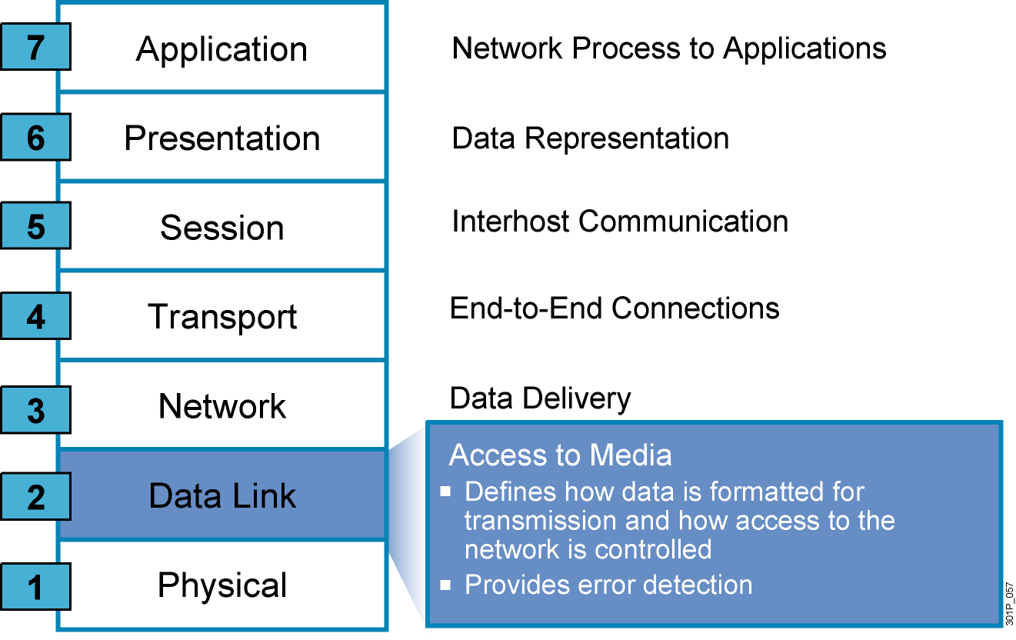
Part 1_Basic Network Elements (Software)
The Seven Layers Functions (Cont.)
Data link
Reliable data transfer across a physical link (Error Control)
Organize the data into Frames, to be put on the physical medium
Check the Frame For errors
Hop to hop addressing

Slide 18
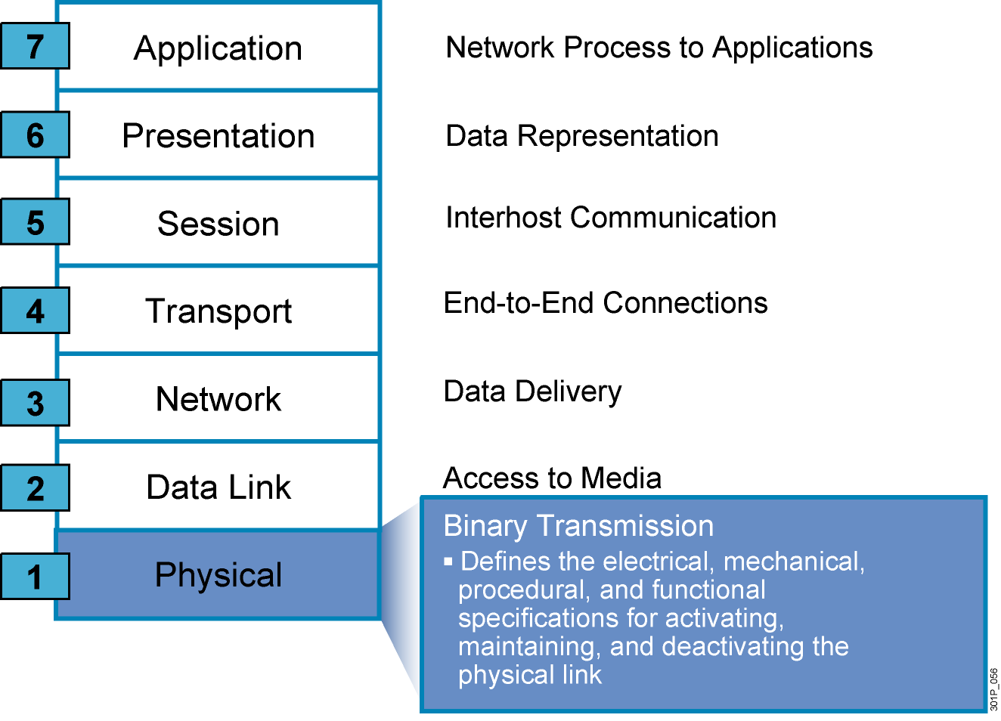
Part 1_Basic Network Elements (Software)
The Seven Layers Functions (Cont.)
Physical
Transmission of unstructured bit stream over the physical link
Deals with the mechanical and electrical specifications of the interface and transmission media (cables and connectors)
Representation of bits

Slide 19
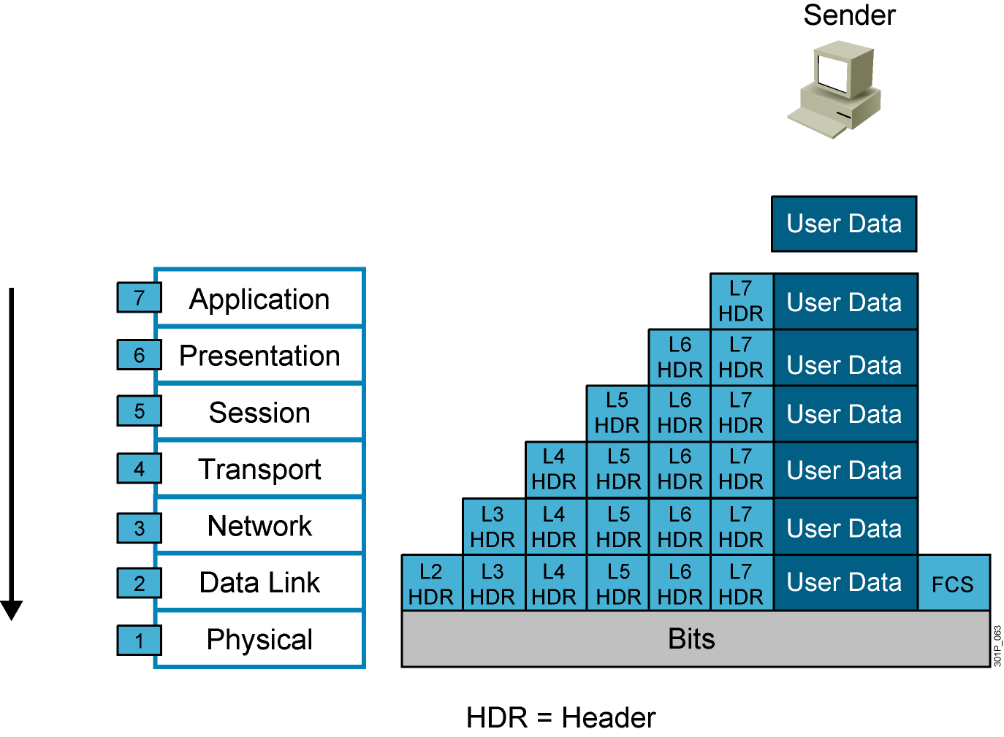

Part 1_Basic Network Elements (Software)
Data Encapsulation
Data De-Encapsulation
(FCS) frame check sequence used for error-detecting/Hash

Slide 20
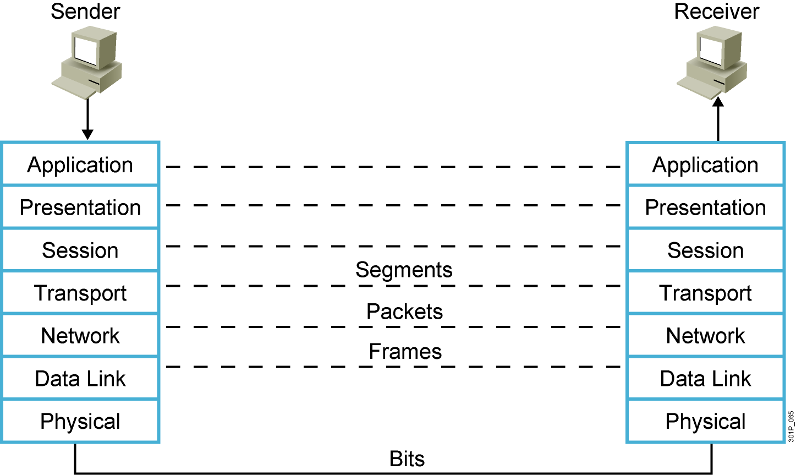
Part 1_Basic Network Elements (Software)
Peer-to-Peer Communication

Slide 21
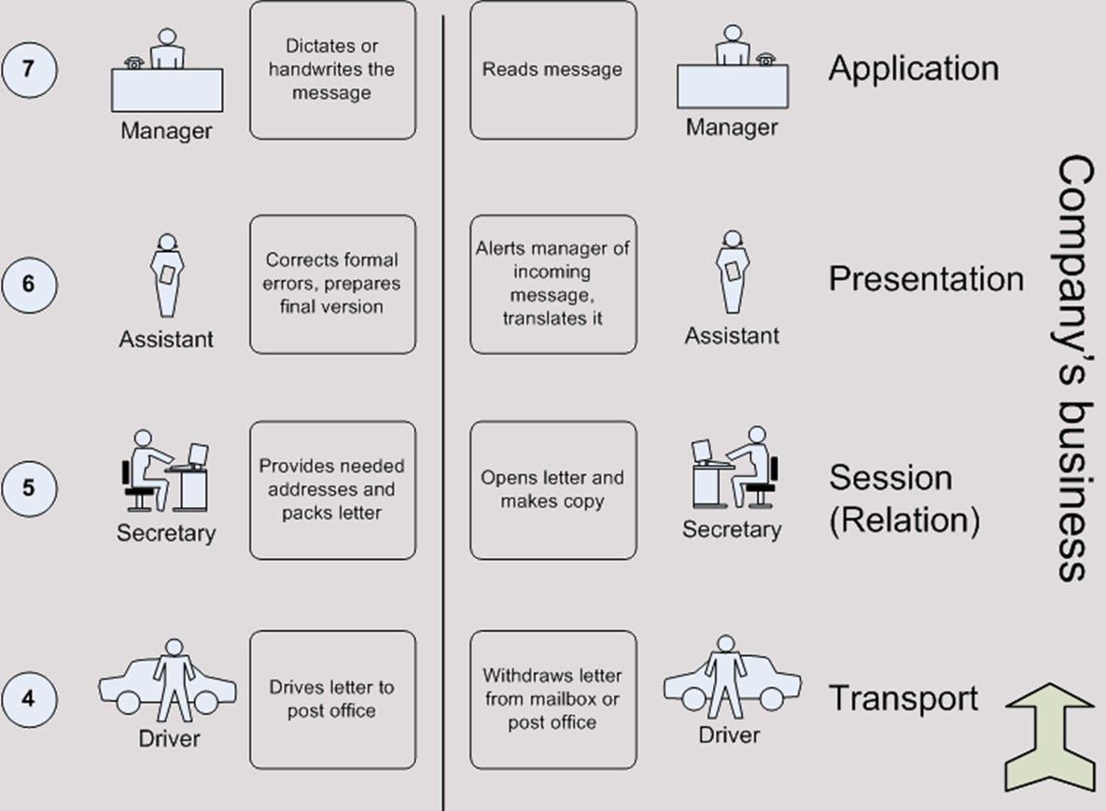
Part 1_Basic Network Elements (Software)
OSI Exercise

Slide 22
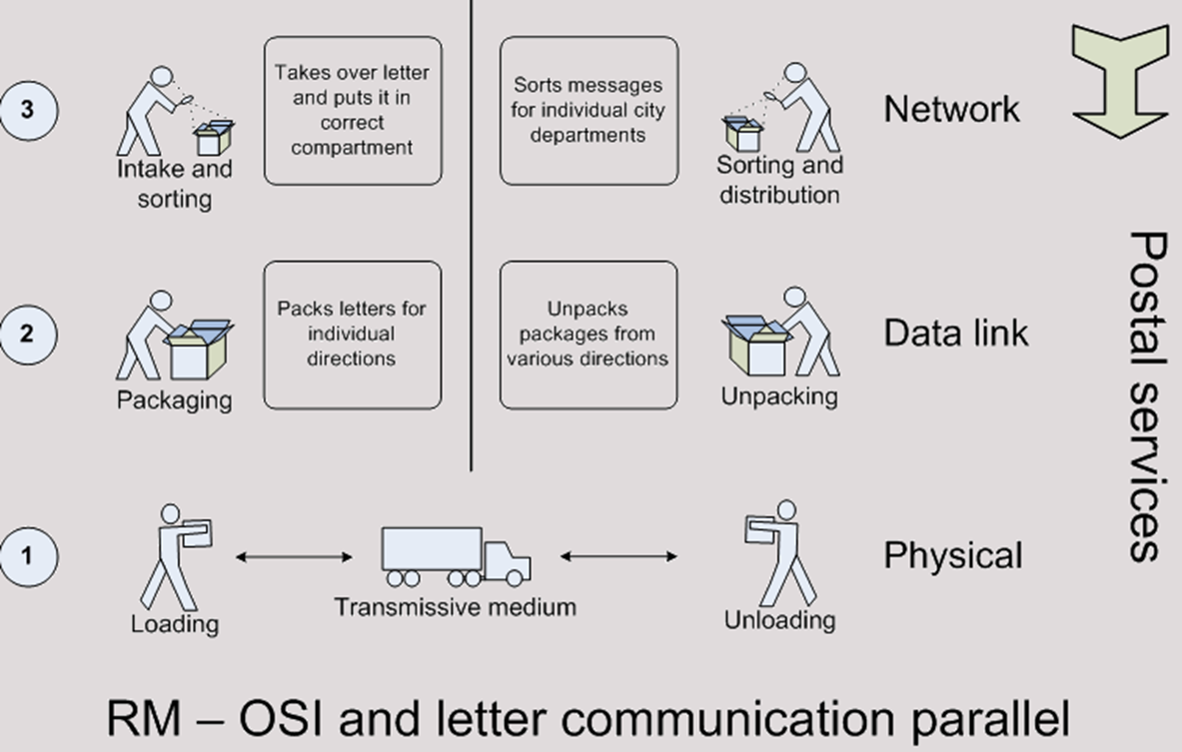
Part 1_Basic Network Elements (Software)
OSI Exercise

Slide 23
Part 1_Basic Network Elements (Software)
Transmission Control Protocol/Internet Protocol TCP /IP

Slide 24
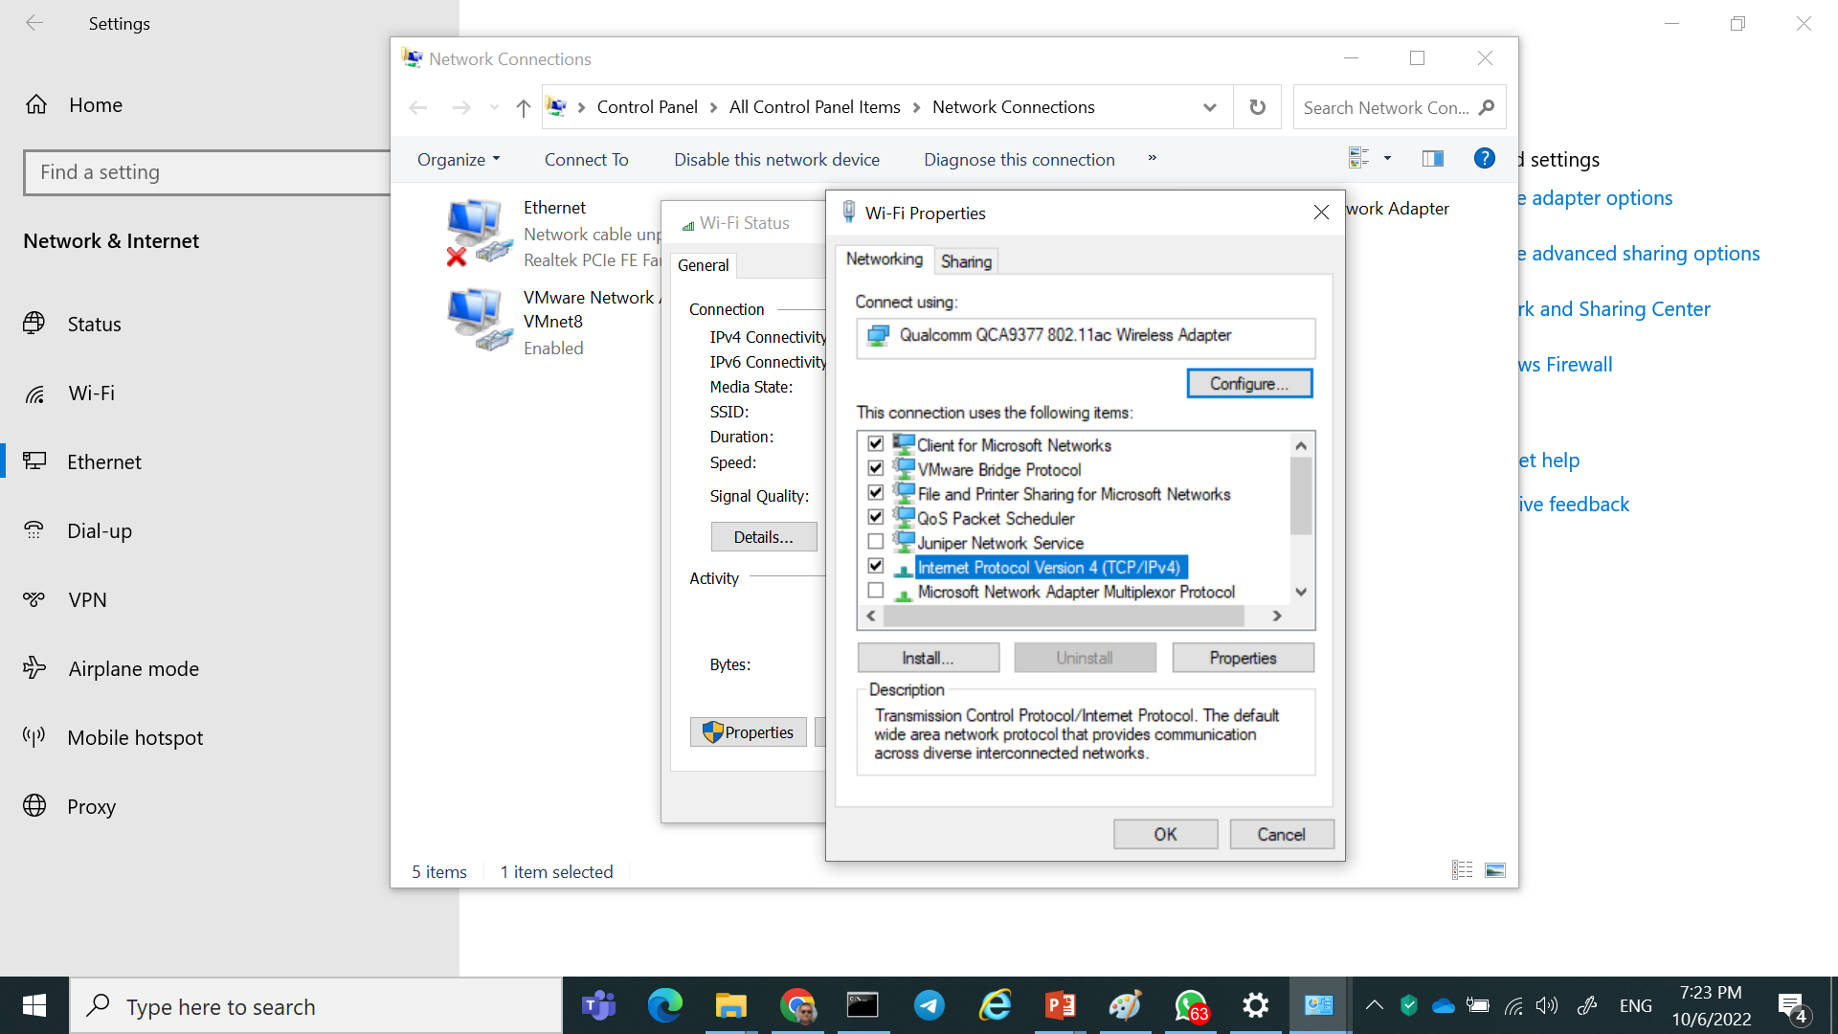
Part 1_ (TCP/IP Protocol Suite)
TCP/IP
Transmission Control Protocol/Internet Protocol.
Open standard protocol
Cross Platform ) default protocol for all modern operating systems (
Microsoft Operating Systems
LINUX Operating Systems
Not tied to one vendor
Direct access to the Internet (TCP/IP is the internet protocol(
Now internet use TCP/IP v4
Next version TCP/IP v6
Routable

Slide 25
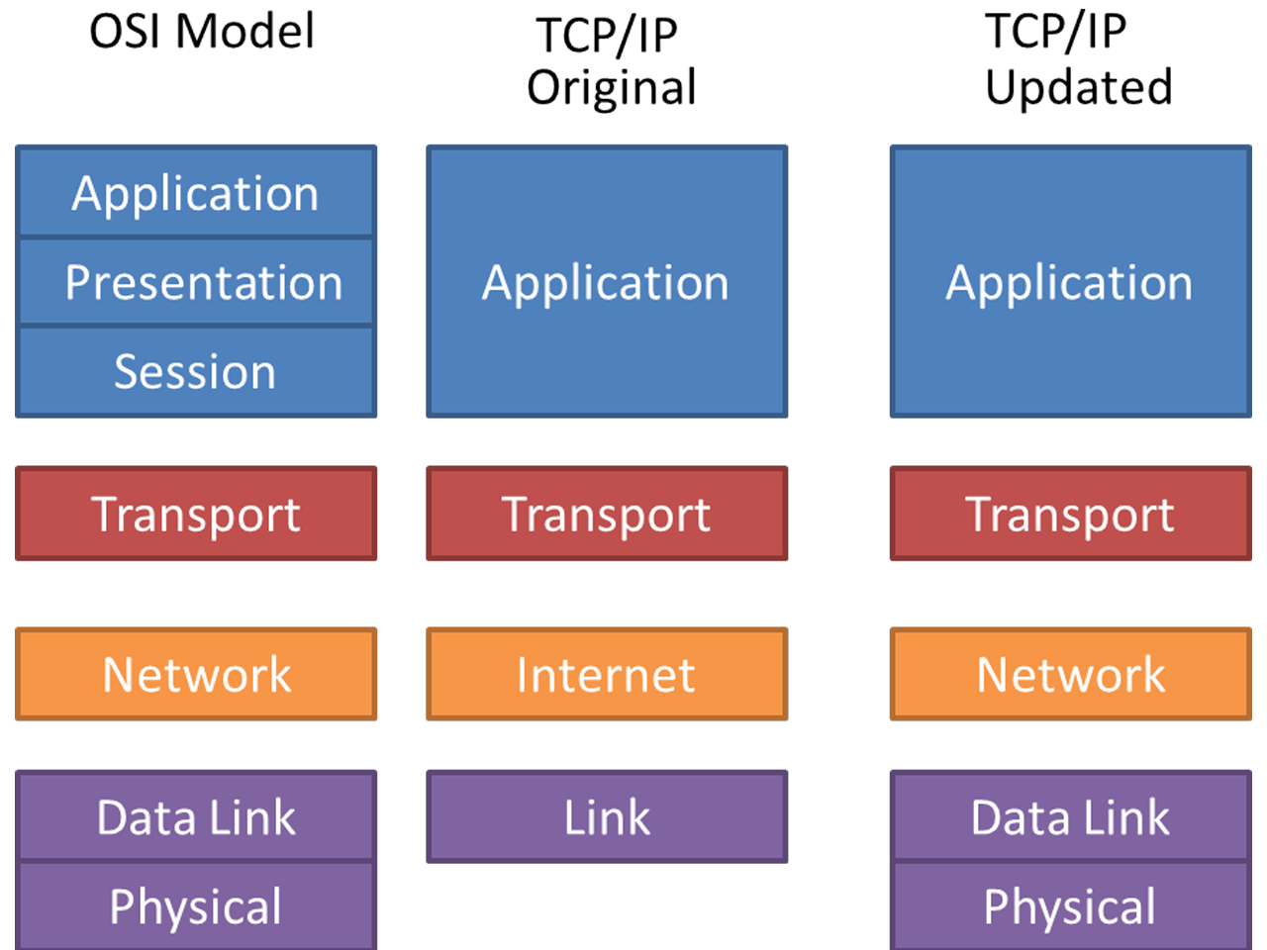
Part 1_(TCP/IP Protocol Suite)
TCP/IP VS. OSI Model

Slide 26
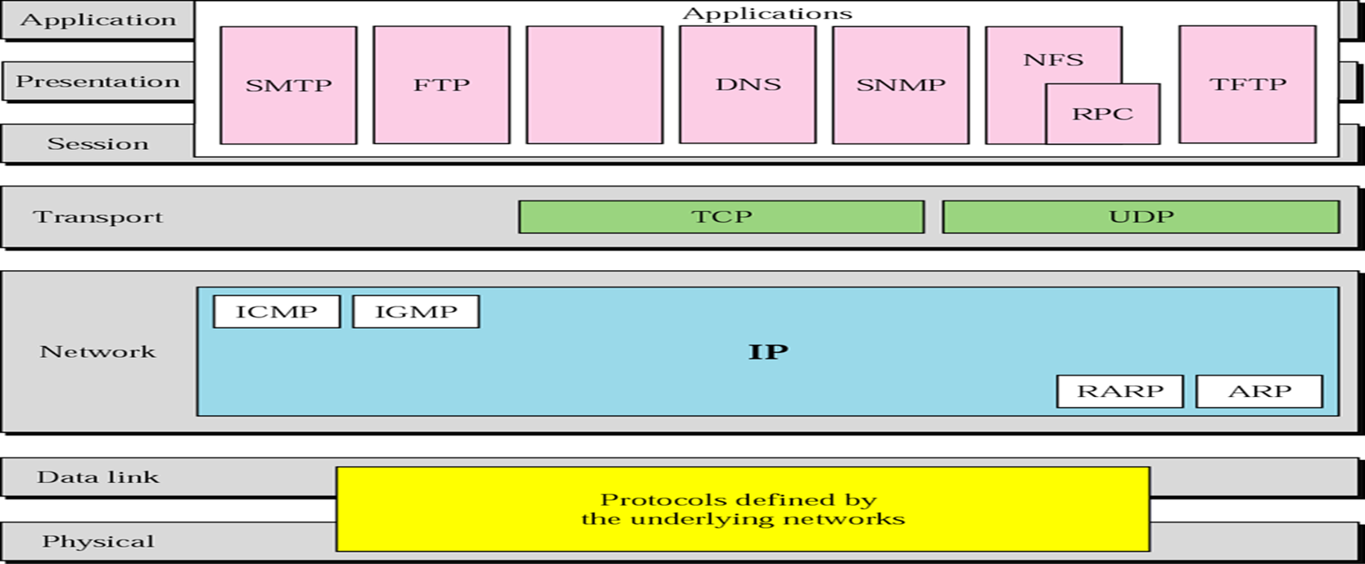
Part 1_(TCP/IP Protocol Architecture)
Some Protocols in TCP/IP Suite

Slide 27
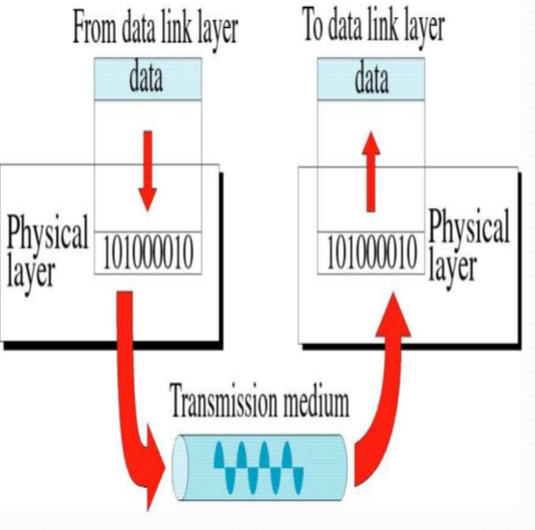
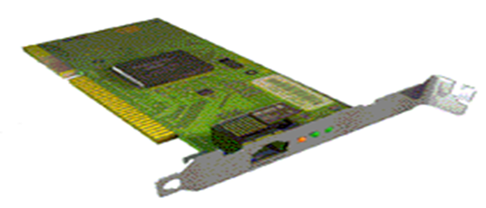
Part 1_(TCP/IP Protocol Architecture)
Physical Layer
defines the electrical, mechanical, Transmission medium
movements of individual Bits from one node to next
Datalink Layer
Logical interface between end system and network
Error notification.
(FRAMES, MEDIA ACCESS CONTROL)
Hop to Hop addressing
Error detection Mechanism (detects damaged or lost frames)

Slide 28
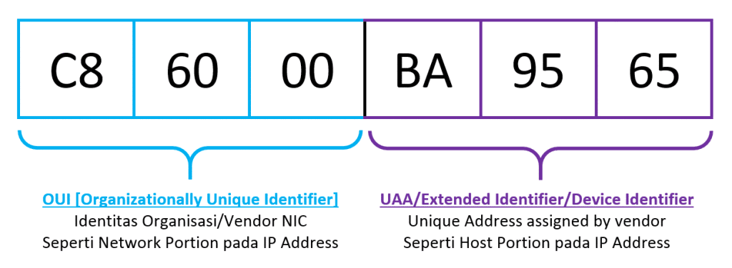
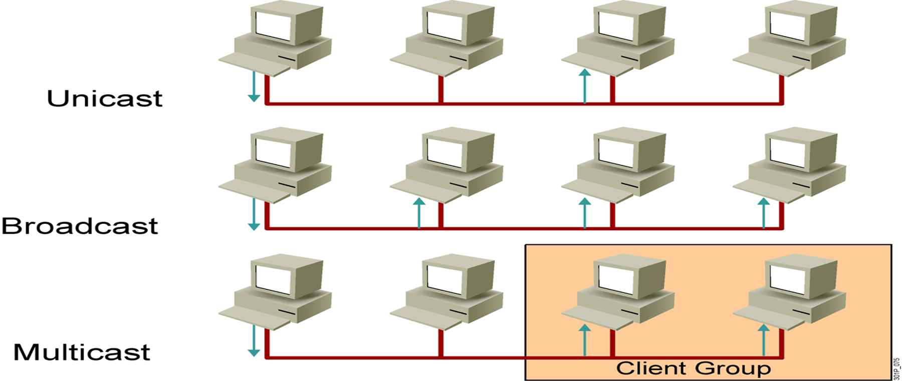
Part 1_(TCP/IP Protocol Architecture)
Physical Addresses (Mac)
Physical Address burned on the card
Unique address over the world
48-bit (6-byte) written as 12 hexadecimal digits;
every byte (2 hexadecimal digits) is separated by a colon
Physical addresses can be either
Unicast
Multicast
Broadcast
To check your physical address: -
Ipconfig /all
GetMac

Slide 29
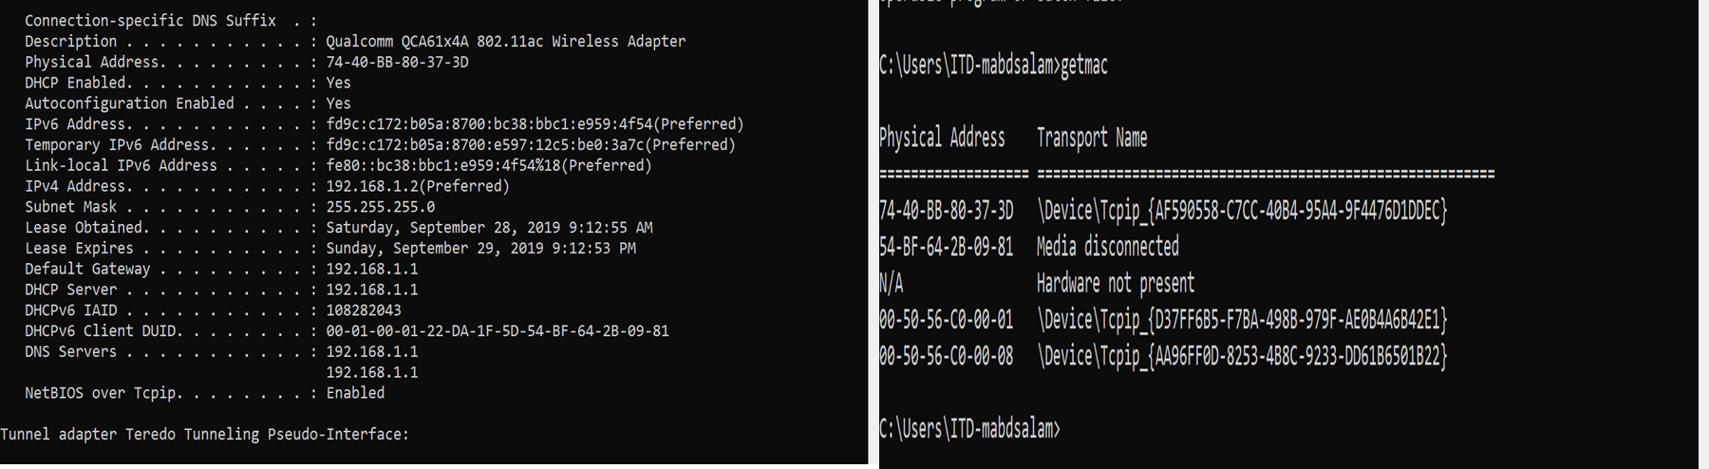
Part 1_ Lab (Practices)
In your lab
To check your physical address: -
Ipconfig /all
GetMac
GetMac /v

Slide 30
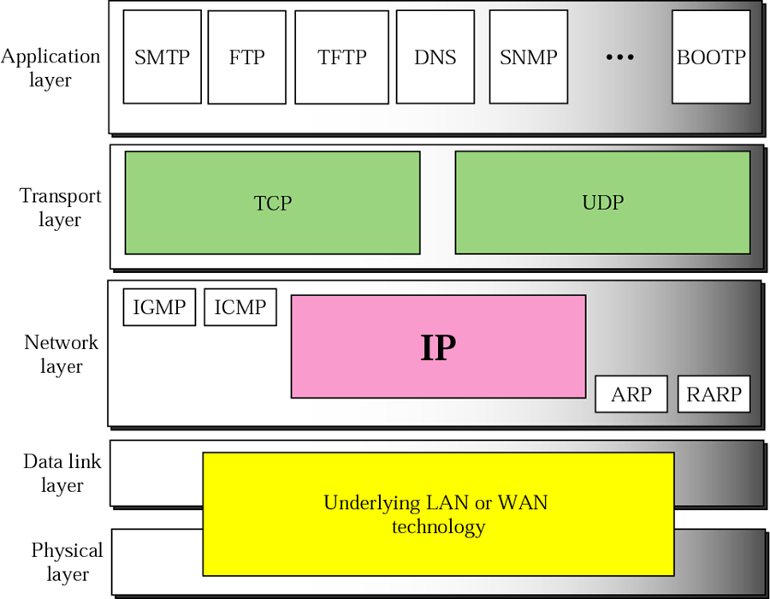
Part 1 (TCP/IP Protocol Architecture)
Internet / Network protocol Layer (IP Layer)
Provides connectivity and path selection between two hosts (Source to Destination)
Routing of data (Provide mechanism to transmit data over independent networks that are linked together)
Logical addressing IPV4 , IPV6

Slide 31
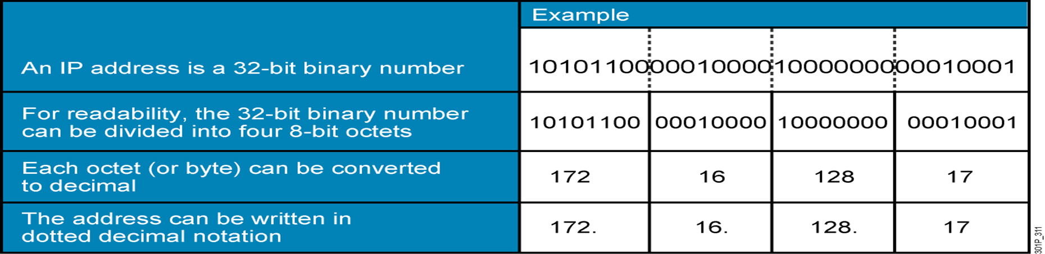
Part 1 (TCP/IP Protocol Architecture)
Internet Protocol (IP V4)
Uniquely identify each device on an IP network layer.
Some times we called it the logical address
Every host (computer, networking device, peripheral) must have a unique address at the same network
The IP address 32 bit divided into 4 octets each octet 8 bit
1 octet = 8 bit each represents from 0 to 255 separated with dots
The address space of IPv4 is 232 or 4,294,967,296

Slide 32
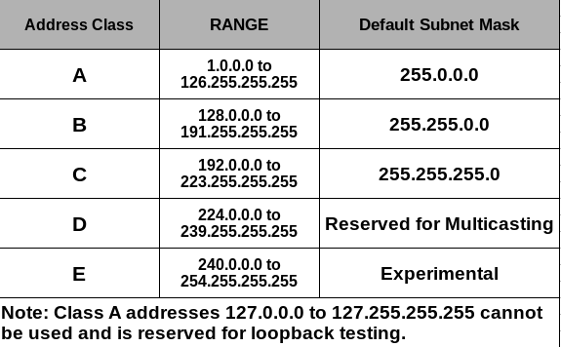
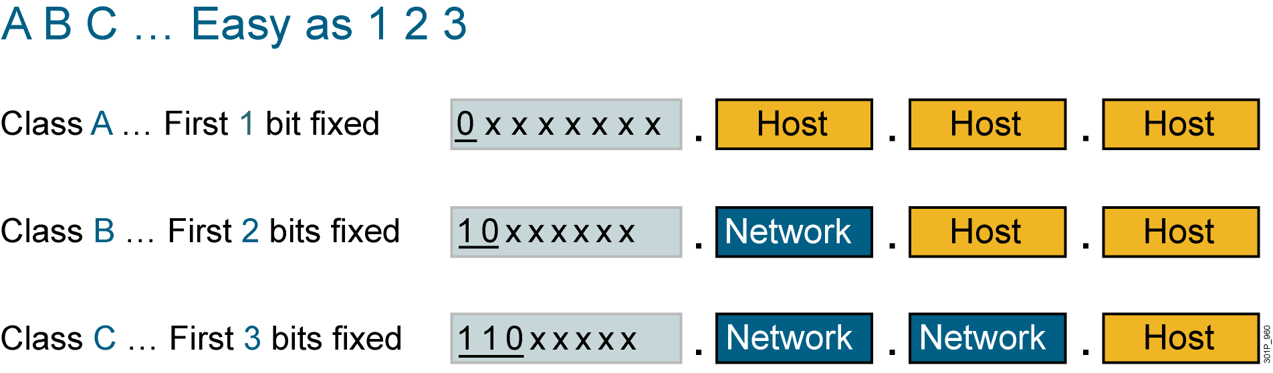
Part 1 (TCP/IP Protocol Architecture)
IP Address Ranges
The First Octet

Slide 33
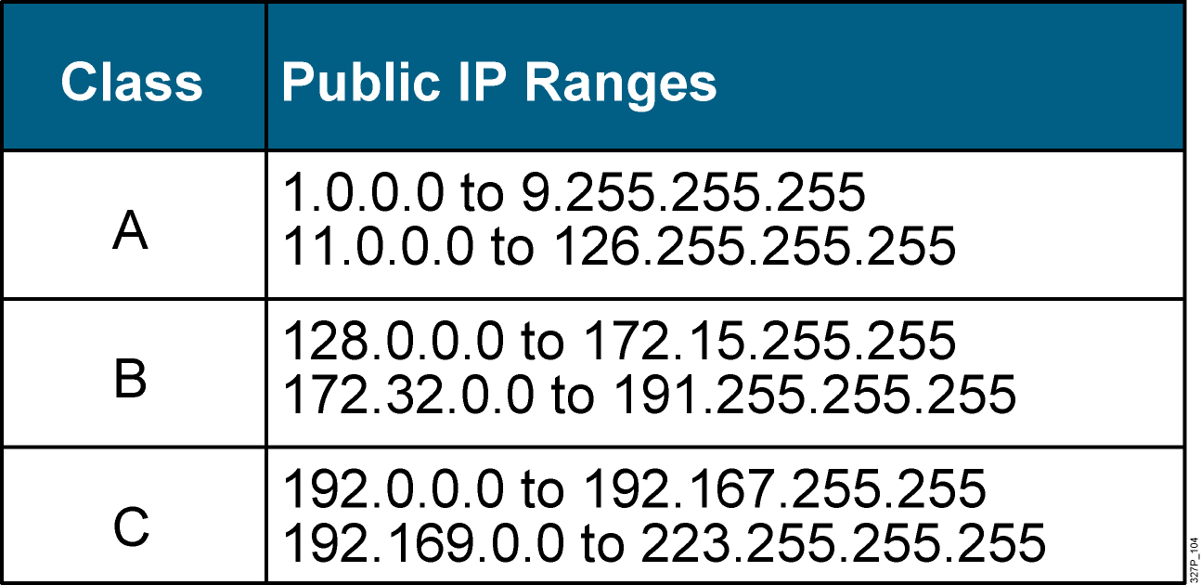
Part 1 (TCP/IP Protocol Architecture)
Public IP Addresses (Real IP)
Private IP Addresses (Local IP)
Class | Private Address Range
A | 10.0.0.0 to 10.255.255.255
B | 172.16.0.0 to 172.31.255.255
C | 192.168.0.0 to 192.168.255 255
Nat is used to Translate the private IP address to public IP addresses.

Slide 34
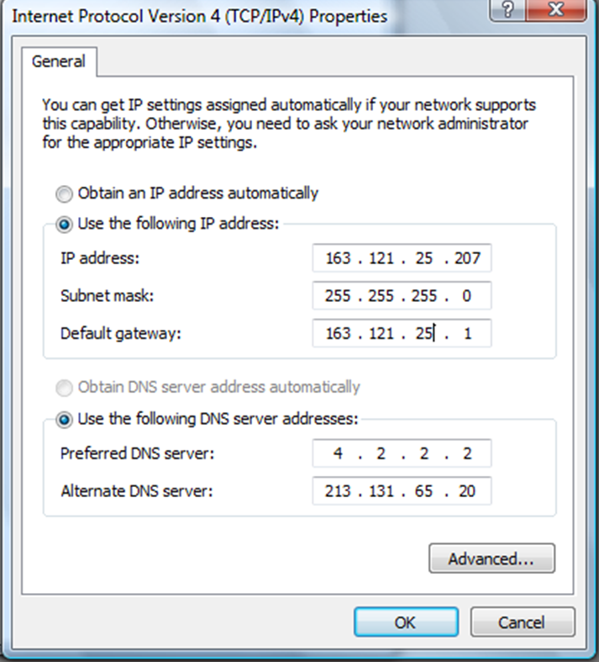
Part 1 (TCP/IP Protocol Architecture)_lab
How to assign IP address to device
Manually
Manually
Automatic
APIPA
Set IP address
Set Subnet mask
Set IP default-Gateway
Set DNS server

Slide 35
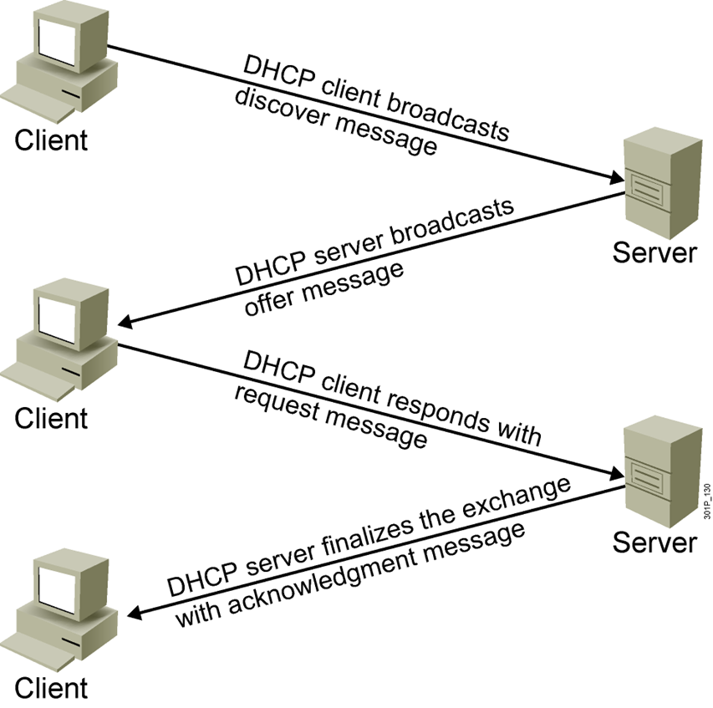
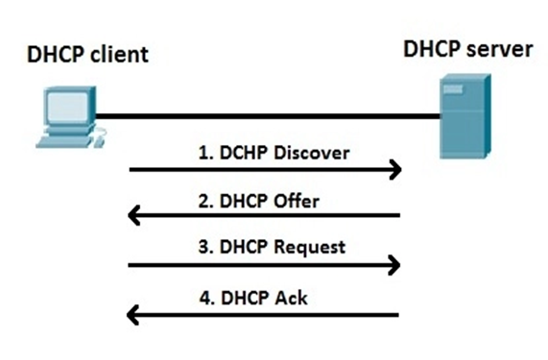
Part 1 (TCP/IP Protocol Architecture)- LAB
Assign IP address Automatic
DHCP Server
used to assign dynamically the IP Configuration including
Host IP
Subnet mask
Default Gateway
DNS server IP
Lease Time
Dora (Discover –Offer-Request-Acknowledgment)
Notes:
DHCP Server: It is used to assign dynamically the IP Configuration including (Host IP, Subnet mask, Default Gateway, DNS server IP and the Lease Time)

Slide 36
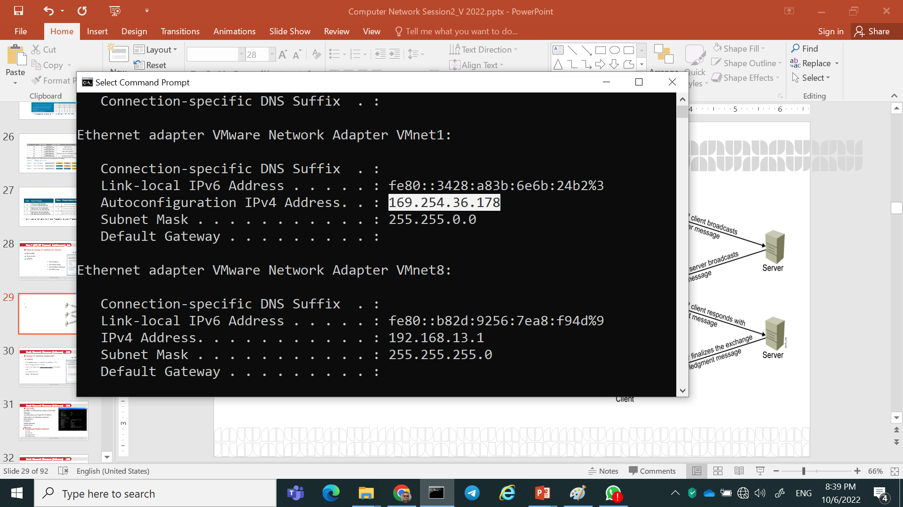
Part 1 (TCP/IP Protocol Architecture)- LAB
Assign IP address Automatic
APIPA
APIPA
If no DHCP server is available the APIPA is used
Auto configuration IP address
let LAN users talk to Each other if the DHCP fails
Can not be Routed
Rang : 169.254.X.X

Slide 37
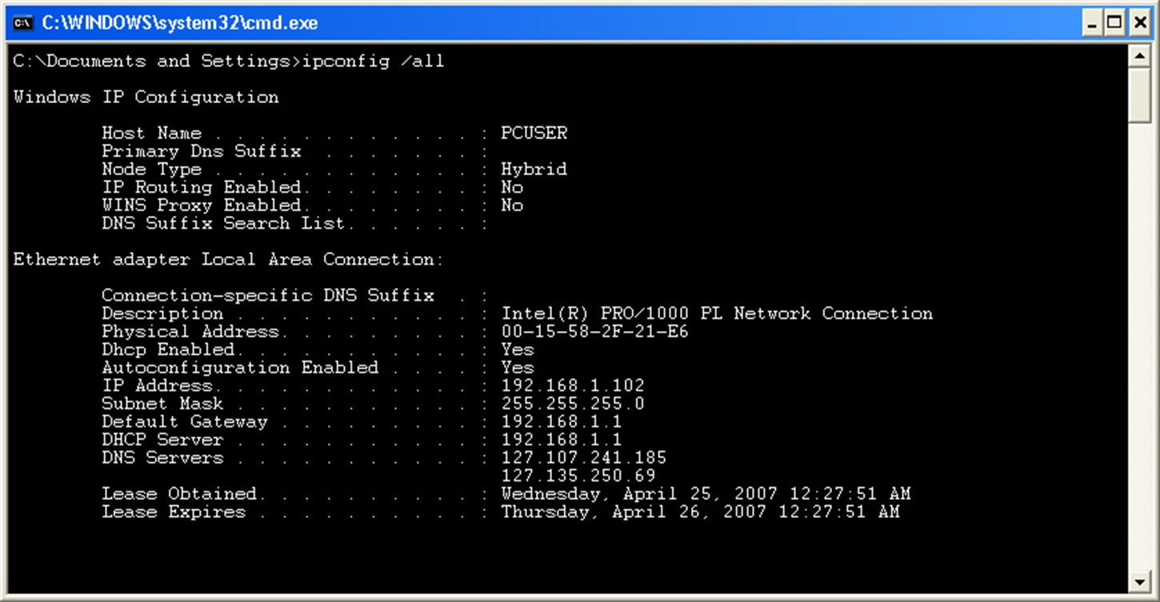
Part 1 (TCP/IP Protocol Architecture)- LAB
Ipconfig
Ipconfig is a command line utility in Microsoft Windows.
ipconfig allows you to get the IP address information of a Windows computer such as :
Physical Address (MAC)
IP address
Subnet mask
Default gateway
DNS server
To know your Private IP addresses
Ipconfig
Ipconfig /all
Ipconfig /release
Ipconfig /renew

Slide 38
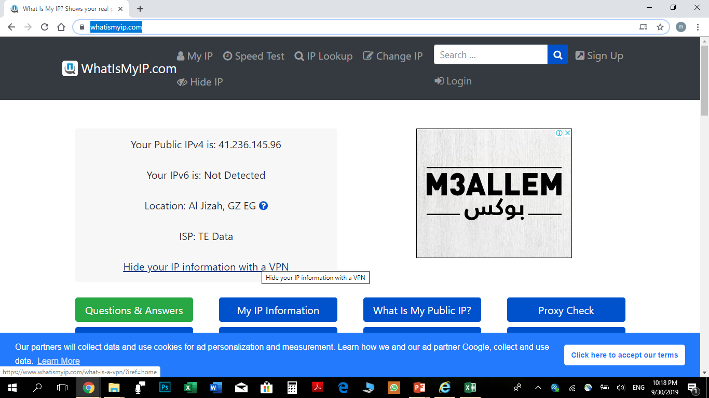
Part 1 (TCP/IP Protocol Architecture)- LAB
- To know your real IP addresses https://www.whatismyip.com/
-To get bulk of the Public IP address you get it from your Internet service provider
- With the grow the of the pubic IP address we used NAT and IPV6

Slide 39
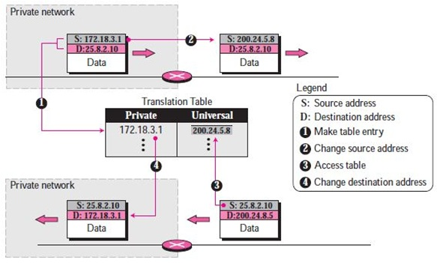
Part 1 (TCP/IP Protocol Architecture)
Network Address Translation(NAT)
The technology allows a site to use a set of private addresses for internal communication and a set of global Internet addresses (at least one) for communication with the rest of the world

Slide 40
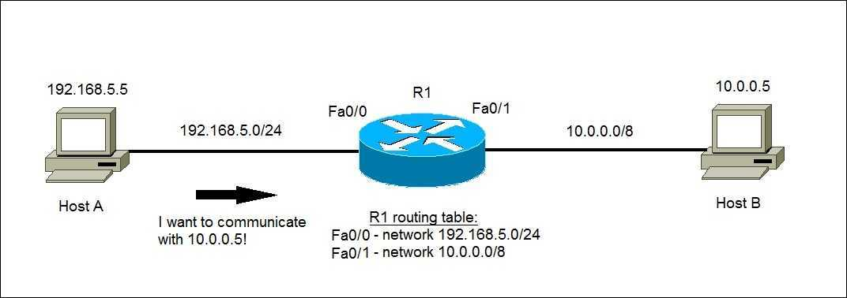
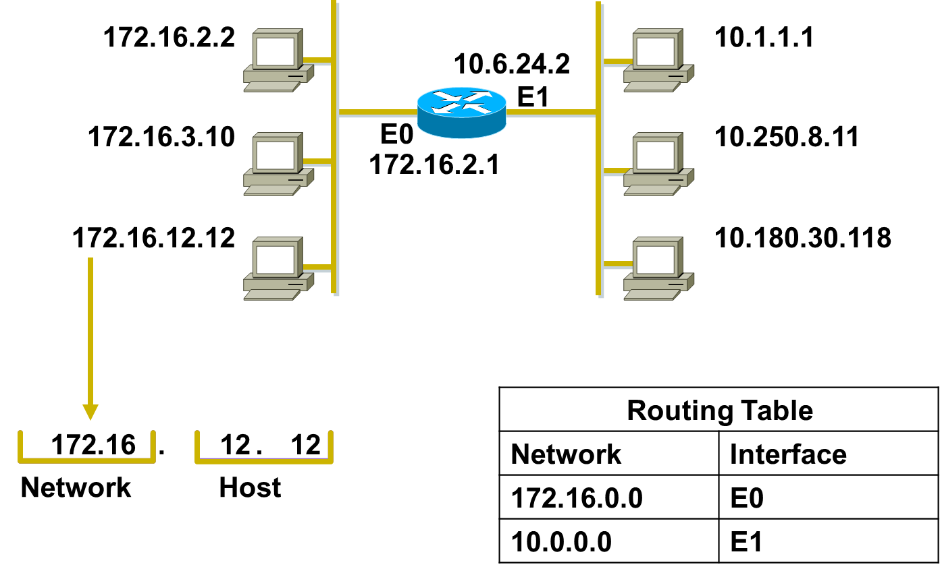
Part 1 (TCP/IP Protocol Architecture)- LAB
Host Addresses & routing
- Identifies the individual host
-Assigned by organizations to individual devices
-Router maintain network information to route the data
Notes:
Purpose: This figure presents an overview of host and network address conventions.
Emphasize: In the example, 172.16.0.0 and 10.0.0.0 refer to the wires at each end of the router.
Explain how the routing table is used. Entries in the routing table refer to the network only. The router does not know the location of hosts; it knows the location of networks.

Slide 41
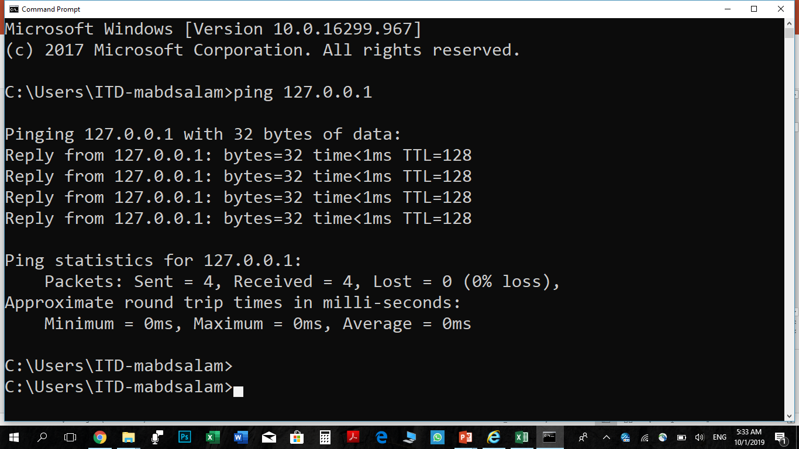
Part 1 (TCP/IP Protocol Architecture)- LAB
ICMP → Ping
Ping is a command line utility in Microsoft Windows.
Ping allows you to check connectivity with other devices
Ping is a tool of DOS attack
Tray in your lab
Ping IP
Ping URL
Ping IP -l
Ping IP -n
Ping IP -t

Slide 42
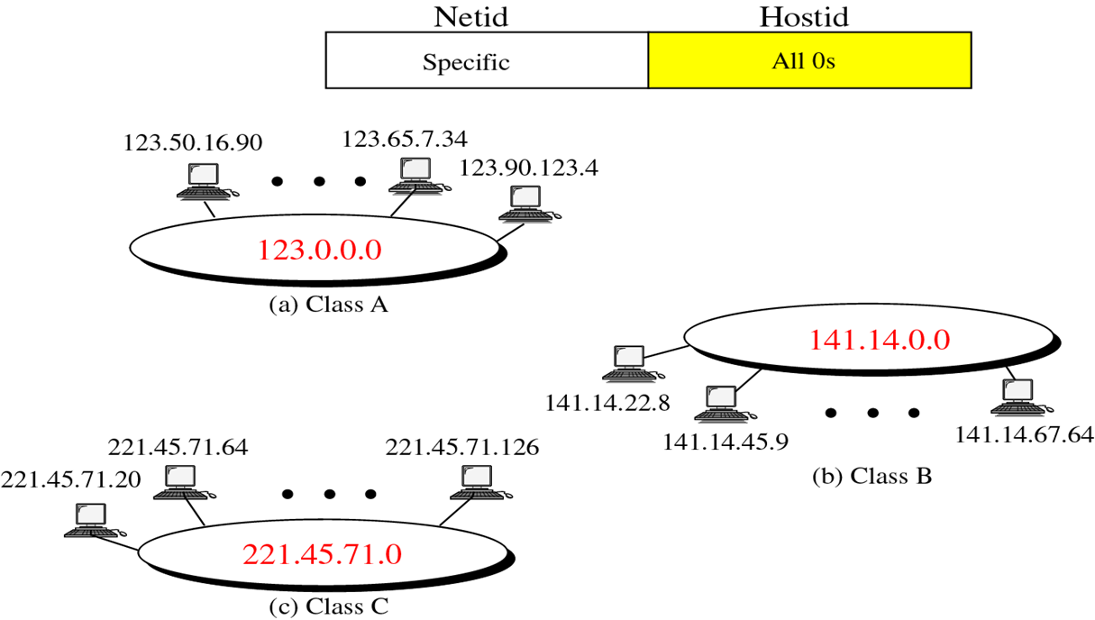
Part 1 (TCP/IP Protocol Architecture)
Reserved Address
Network address:
reserved
can not be assigned to any device
used for routing by the router
Class A: 10.0.0.0
Class B: 172.16.0.0
Class C: 192. 168.1.0

Slide 43
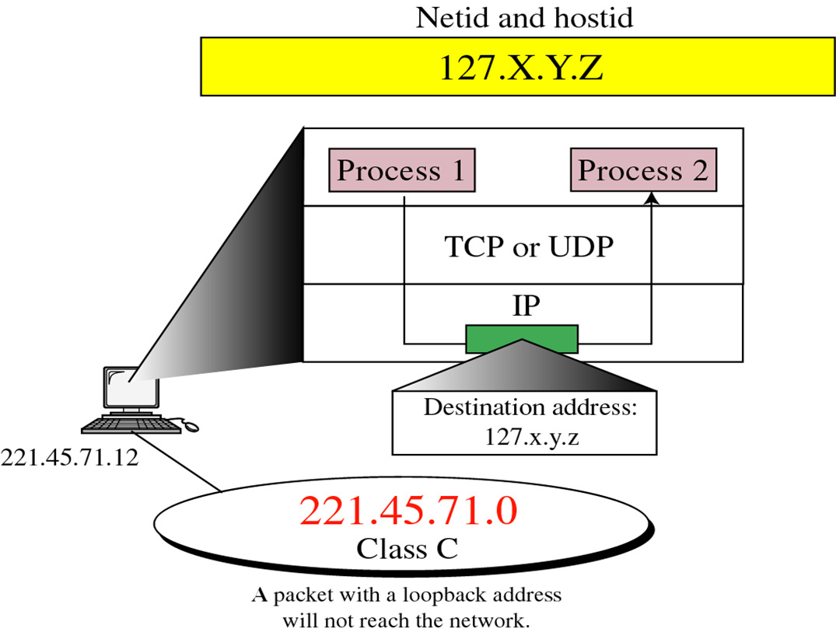
Part 1 (TCP/IP Protocol Architecture)
Reserved Address
Loop back Address
- Loopback address: It is used just for testing
-the TCP/IP Protocol Suit 127.0.0.1 example test NIC

Slide 44
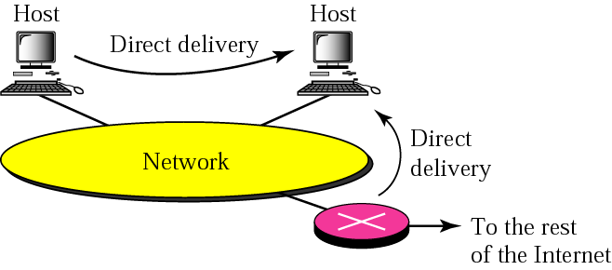
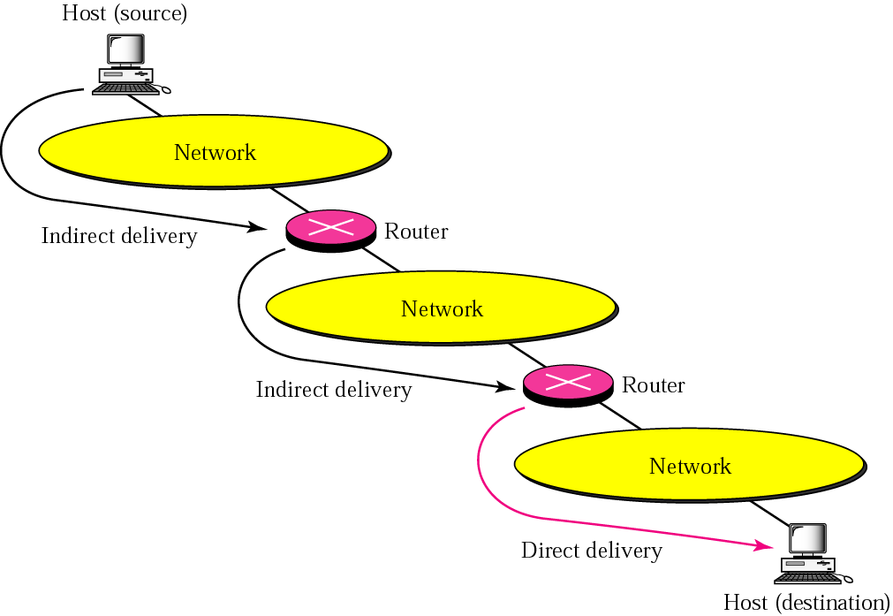
Part 1 (TCP/IP Protocol Architecture)
Delivery of IP Packets
Direct delivery
Indirect delivery

Slide 45
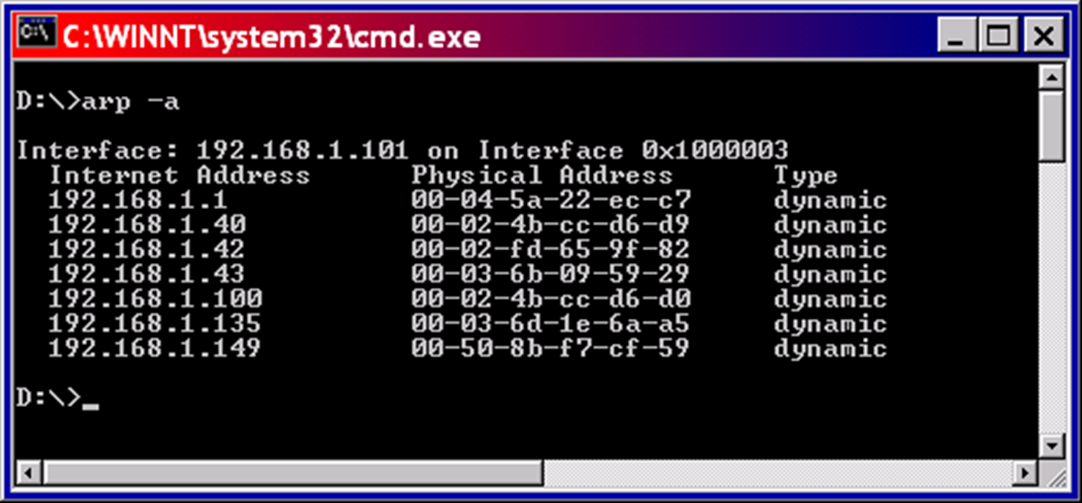
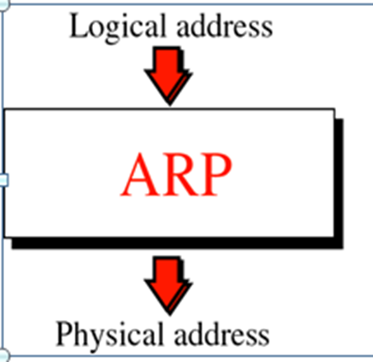
Part 1 (TCP/IP Protocol Architecture)- LAB
ARP (Address Resolution Protocol)
Arp -a
ARP Table

Slide 46
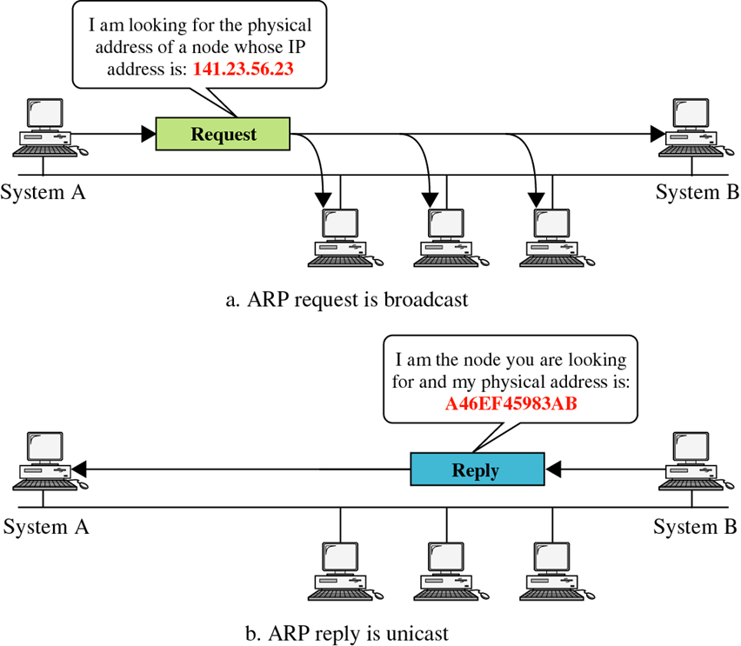
Part 1 (TCP/IP Protocol Architecture)
ARP operation

Slide 47
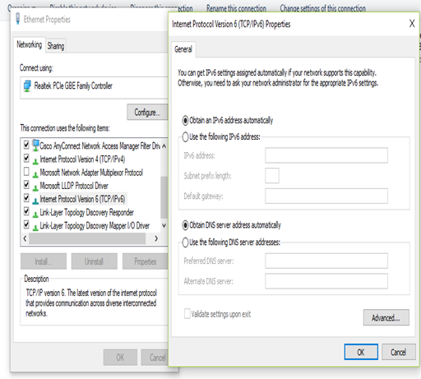
Session 1 (TCP/IP Protocol Architecture)
Internet Protocol (IP V6)
128-bit address, provides approximately (340,282,366,920,938,463,463,374,607,431,768,211,456) = approximately 340 undecillion, or 340 billion billion billion billion, addresses)
Represented as eight groups, separated by colons, of four hexadecimal digits. The full representation may be simplified by several methods of notation;
2001:0db8:0000:0000:0000:8a2e:0370:7334 = 2001:db8::8a2e:370:7334

Slide 48
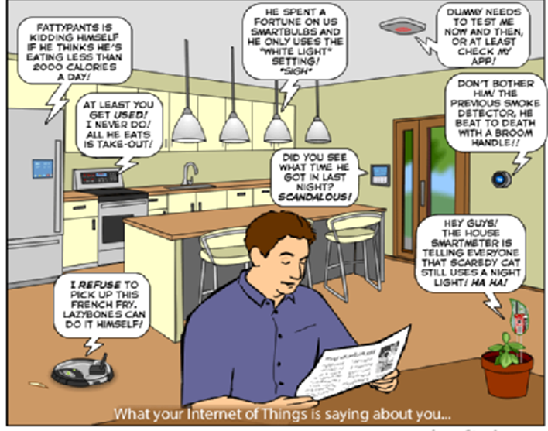
Session 1 (TCP/IP Protocol Architecture)
Internet Of Things (IOT)
Aims connect all devices to the existing Internet infrastructure.
"things" that sense and collect data and send it to the internet.
(Eg:- coffee maker, A.C, Washing Machine, Ceiling Fan, lights , any thing ) having sensors can be connected with internet.
PRACTICAL APPLICATIONS:-
Smart Homes -Smart Cities-Energy - Environment monitoring- healthcare- Management

Slide 49
Thank You

